Slide 1
Keratin
By: Lara Glendening, Blake Carlile, Dean Kidder-Buell, and Casey Elmhirst
aditya

Slide 2
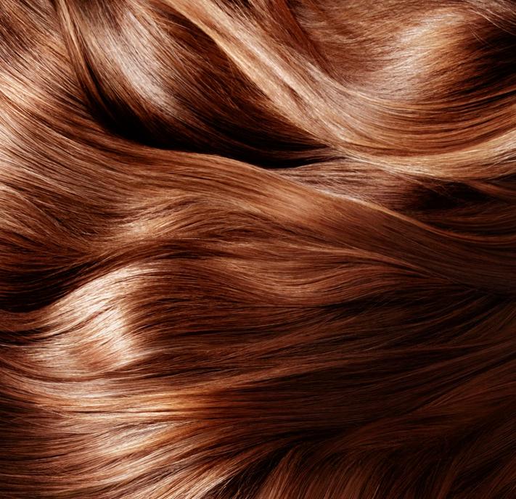
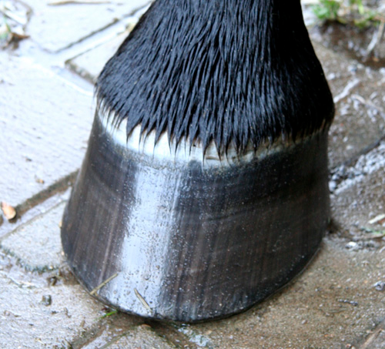
Introduction of Keratin
Keratin is the main structural component of hair, horns, feathers, hooves, skin, and claws. Keratin is very flexible and water resistant. It is made by keratinocytes.

Slide 3
Genetic code of Keratin

Slide 4
Transcription (DNA to mRNA)
Takes place in the nucleus
Helicase unwinds the DNA
RNA polymerase binds to the DNA and matches it to RNA
mRNA that is patterned after the DNA is created
Polymerase detaches when it reaches a termination signal
mRNA moves out of the nucleus

Slide 5
Base Pairing
In DNA, Adenine pairs with Thymine and Guanine pairs with Cytosine
In RNA, Thymine is replaced with Uracil
In transcription, the enzymes split the DNA strand and synthesize base pairs complementary to the ones of the DNA
This reduces mutations by making sure DNA is transcribed to RNA correctly

Slide 6
RNA code of Keratin

Slide 7
Translation (mRNA to Protein)
Takes place in ribosomes
mRNA moves to ribosomes and is “read” by tRNA
tRNA analyzes the codons (sets of three nucleotides) on the mRNA and brings the right amino acid into the polypeptide chain that is being made
Amino acids combine in the correct sequence
Polypeptide chain folds in the way that is coded by the amino acids
Now we have a protein!

Slide 8
Protein folding
The protein is in its primary structure
Protein folds to form secondary structure (either a helix or b sheet)
Side chains of amino acids interact, forming tertiary structure
Localization of hydrophobic and hydrophilic amino acids help determine tertiary structure
The final level is quaternary structure
Consists of interactions between polypeptide chains in proteins with multiple polypeptides

Slide 9
Protein Structure of Keratin
met=methionine ser=serine glu=glutamic acid
leu=leucine tyr=tyrosine ile=isoleucine

Slide 10
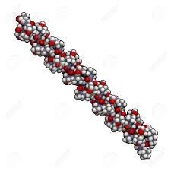
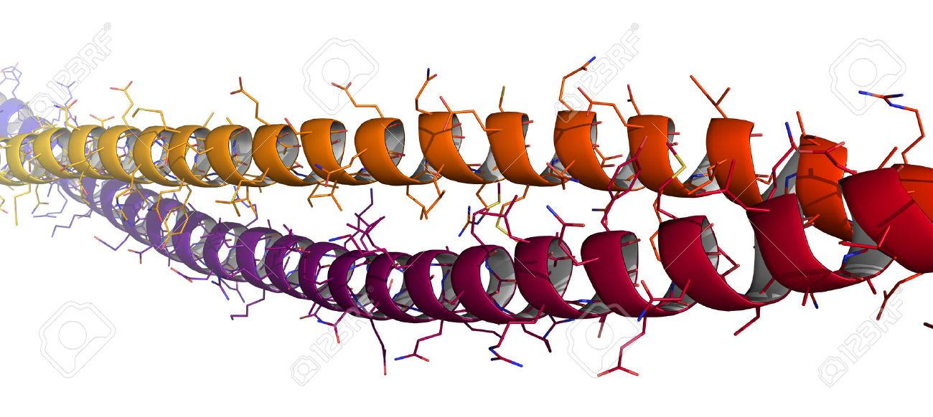
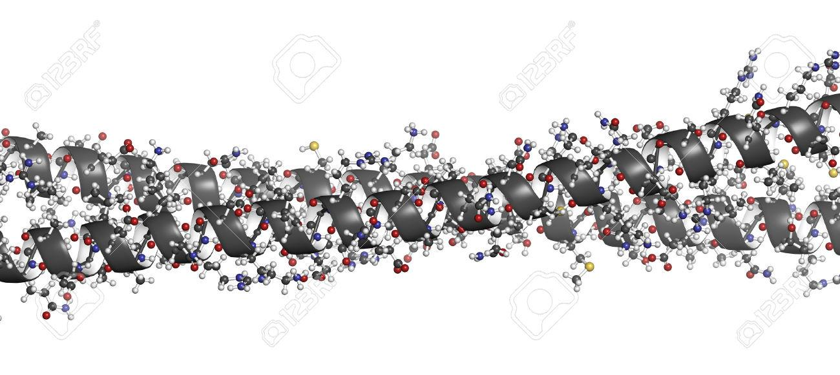
Model of Protein
Keratin has a coiled-coil structure (two coiled strands twisted around each other)

Slide 11
Function
Adheres cells to each other. Epithelial cells link together using desmosomes. The desmosomes hold the cell together individually and Keratin holds the desmosomes to the cell
Forms a protective layer on the outside of the skin to hold epidermis together

Slide 12
The end!

